Slide 1
SONG ANALYSIS With Power BI

Slide 2

Topics Covered
Introduction
Project Overview
Data Sets
Tasks
Conclusion

Slide 3
Introduction
In an era where music shapes cultural trends and consumer behaviors, understanding the metrics behind YouTube song performances is crucial. Using Power BI, we delve into the data to uncover compelling insights. From viewer engagement trends to geographical reach and demographic preferences, this analysis offers a comprehensive view of how songs resonate in the digital landscape. By visualizing data through interactive dashboards and robust analytics, we aim to uncover patterns that illuminate the factors driving popularity and audience engagement on one of the world’s largest video platforms.

Slide 4
Project Overview
This internship project aims to conduct a comprehensive analysis of YouTube songs data using Power BI. The dataset contains key attributes such as video ID, channel title, title, description, tags, published date, view count, like count, favorite count, comment count, video duration, video definition, and caption details. The goal is to utilize Power BI to create insightful visualizations and reports that provide a deeper understanding of YouTube songs' performance, popularity, and user engagement. The analysis aims to uncover trends, preferences, and patterns in the data to aid content creators and stakeholders in optimizing their YouTube song content.

Slide 5
Data Sets
video_id: Unique identifier for each YouTube video.
channel Title: Title of the YouTube channel publishing the song.
title: Title of the YouTube song video.
description: Description provided for the YouTube song video.
tags: Tags associated with the YouTube song video.
published At: Date and time when the YouTube song video was published.
view Count: Number of views received by the YouTube song video.
like Count: Number of likes received by the YouTube song video.
favorite Count: Number of times the YouTube song video has been marked as a favorite.
Comment Count: Number of comments posted on the YouTube song video.
duration: Duration of the YouTube song video.
definition: Video definition or quality (e.g., HD, SD).
caption: Availability of captions for the YouTube song video.

Slide 6
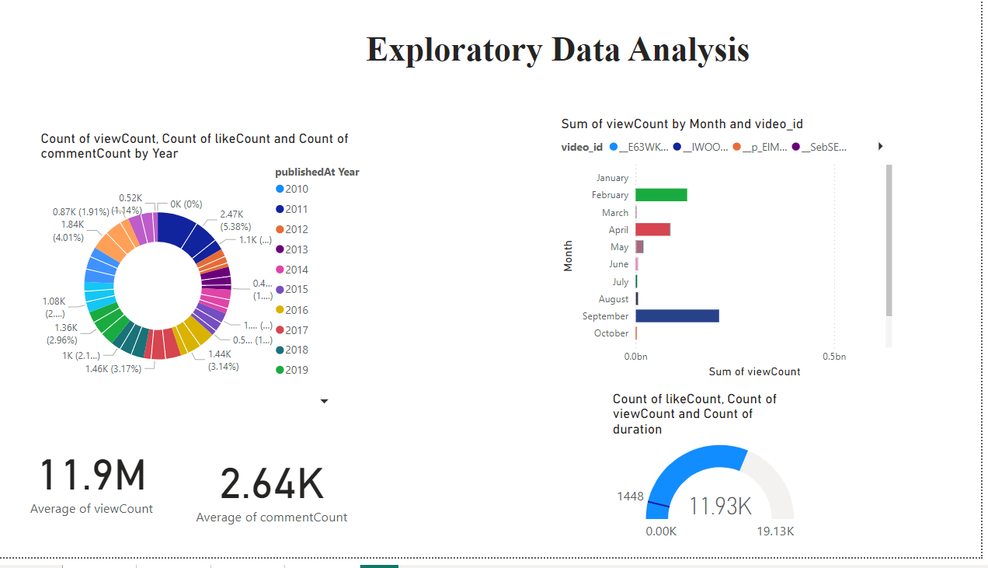
Tasks

Slide 7
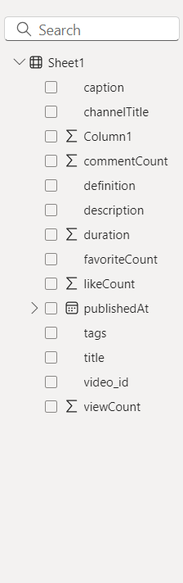
Data Cleaning and Preparation

Slide 8
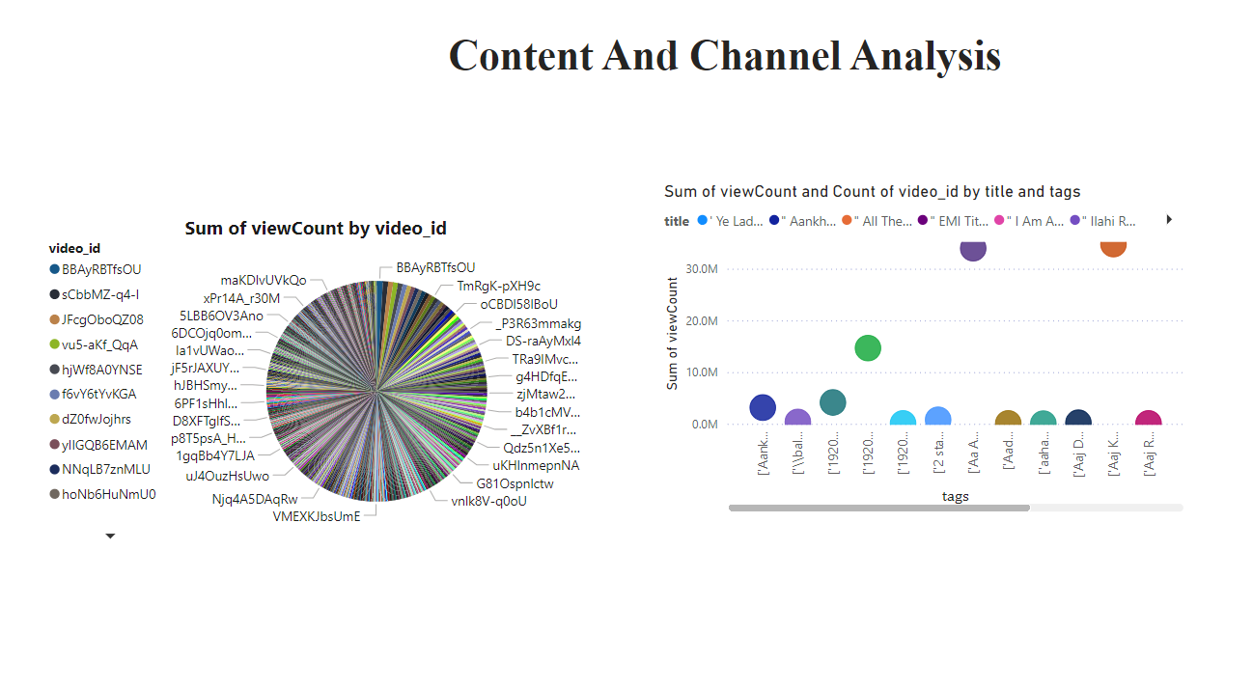
Content And Channel Analysis

Slide 9
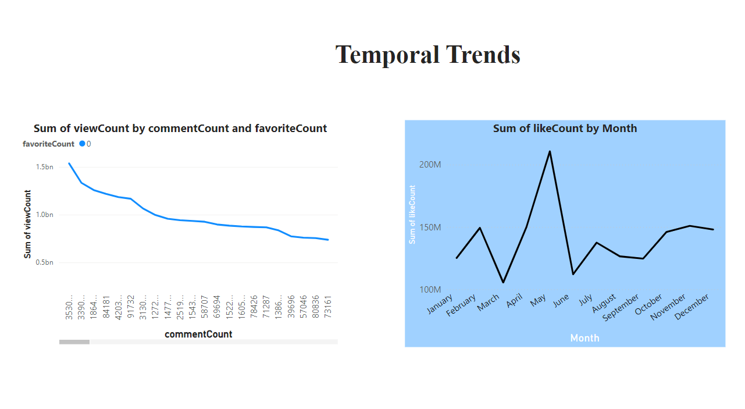
Temporal Trends

Slide 10
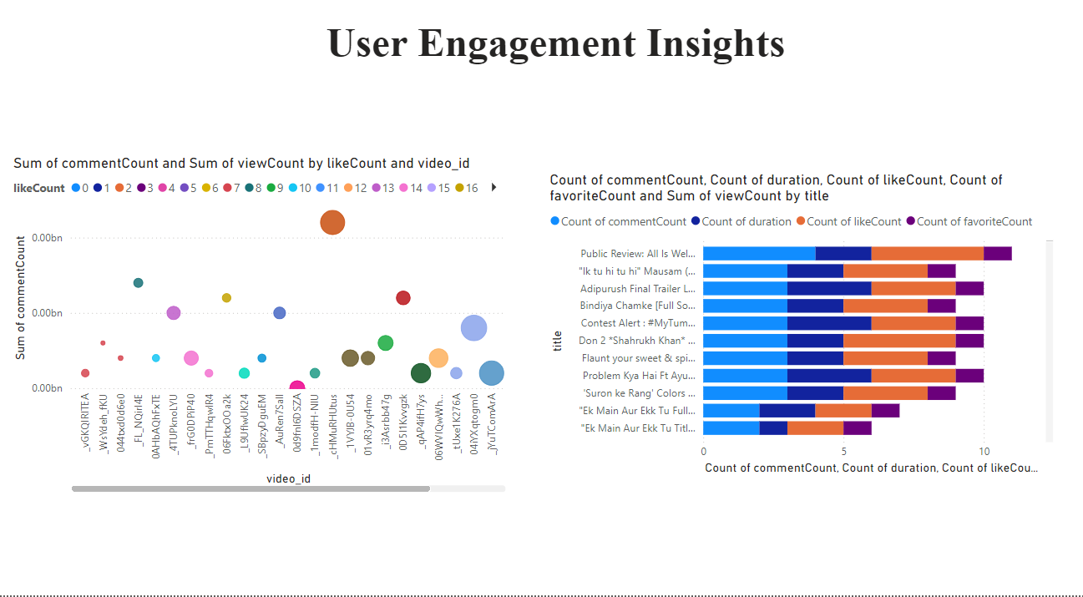
User Engagement Insights

Slide 11
Conclusion
This project provides us with hands-on experience in leveraging Power BI for meaningful analysis in the dynamic domain of YouTube songs, contributing insights to optimize content strategy and engagement. By using this course, we can enhance our skills. By using Power bi, we can plot and represent the data very easily. We can show data in various forms like- Bar charts, Line chart, Slicers e.t.c.

